Slide 1
Thriving Waukesha
County Alliance
Building dynamic partnerships
for a stronger community
March, 2016
Notes:
Introductory page
Colors for the Presentation:
Green R: 165 G: 203 B: 22
Purple R: 134 G: 27 B: 109
Orange R: 244 G: 187 B: 71

Slide 2
Thriving Overview
History and Background Priorities / Goals Accomplishments YTD Community Call to Action
Discussion / Questions
Notes:
Agenda page

Slide 3
2011- The Problem…
Decreased revenues and insufficient capacity
Increasing demand (need) for Services
Notes:
Original taskforce vision.

Slide 4
Lead Agencies
United Way of Greater Milwaukee & Waukesha County
Waukesha County Community Foundation
Greater Milwaukee Foundation
Waukesha County Government

Slide 5
Taskforce Recommendations
Capacity Building – Management Efficiency
Community Performance Measures
Role of Funders
Increased Awareness of Services
Capacity Building – Systems and Infrastructure

Slide 6
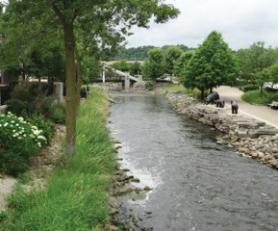
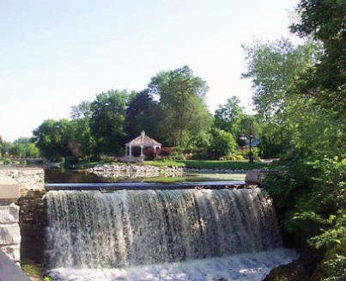
Taskforce Vision
To build a thriving and sustainable nonprofit community that effectively mobilizes community resources and meets the health and human service needs of all who call Waukesha County home.
Menomonee
Falls
Notes:
Original taskforce vision.

Slide 7
Thriving Waukesha County Alliance (TWCA) 2016 Members
Steering Committee
Jean Schultz, Director ProHealth Care, Inc and Thriving Co-Chair
Chris Menden, Director of Market Strategy and Development, Prairie Financial Group, Waukesha State Bank, and Thriving Co-Chair
Fred Gutierrez , Greater Milwaukee Foundation
Jayne Thoma, United Way ‎Vice President Center for Community Collaboration at United Way of Greater Milwaukee & Waukesha County
Kathryn Leverenz, President Waukesha County Community Foundation
Julianne Davan, Public Communications Coordinator, Waukesha County Health and Human Services
Teri Terrill, ED Family Services of Waukesha
Terri Phillips, Project Coordinator, Thriving Staff
Additional Alliance Members
Ed Olson, Business Leader, and Community Volunteer
Bob Glowacki, ED Easter Seals
Mike Erwin, CEO, Tailored Label Products
Antwayne Robertson, Director of Health and Human Services Waukesha County
Angela Mancuso, ED, The Women’s Center
Mary Baer, Business Leader and Community Volunteer
Kathy Gale, ED Interfaith Senior Programs
Stuart Schroeder, Attorney /Founder, The Schroeder Group
Chris Carman, Partner and Business Coach, ActionCoach
Karen Tredwell, ED Food Pantry of Waukesha
Suzanne Kelley, President Waukesha County Business Alliance
Notes:
The Thriving Alliance is growing! As we engage more of our community members in the Thriving initiative, new members are joining the Alliance.
The 2016 roster is still in flux as a few members of our business community are considering their role.

Slide 8
Thriving Waukesha County Alliance (TWCA)
Steering Committee
Project Coordinator
Thriving Work Groups
Thriving Leadership Network
Thriving Funders Collaborative
Performance Measures
Administrative and Communications
Support
Strategic Collaborations-Collective Impact
Homelessness Affinity Group Transportation Affinity Group

Slide 9
Thriving Waukesha County Alliance Mission:
To create long term sustainability and optimal capacity of the health and human services sector.
Notes:
Mission and vision are under review

Slide 10
Thriving is an Advocate and Catalyst for:
Building Capacity
Aligning community resources to collectively address complex social issues
Informing Donor and Funder Resource Investments

Slide 11
TWCA Priorities
System-wide Advancement
Key Priority Initiatives
Homelessness
Transportation
Catalyst for strategic collaborations
Notes:
Might be able to explain here why homelessness and transportation as well.

Slide 12
TWCA Priorities
System-wide Advancement
Key Priority Initiatives
Homelessness
Transportation
Catalyst for strategic collaborations
Notes:
Might be able to explain here why homelessness and transportation as well.

Slide 13
TWCA Priorities System Wide Advancement
Goal 1: Increase the capacity and effectiveness of Waukesha County human services nonprofit providers
Notes:
This goal speaks specifically to increasing the capacity of the nonprofits who serve the human services sector.
Thriving is working to strengthen leadership through connecting agencies to capacity building resources.
Our research also indicated that the funders play key role as well. These two areas are our focus for this specific goal.

Slide 14
TWCA Priorities System Wide Advancement
Improve agency access to existing capacity building resources to strengthen their ability to deliver on their mission
Build understanding of Collective Impact and engage community on specific issues
Funders collaborate to assess common funding priorities and opportunities for joint planning

Slide 15
2015 System Wide Advancement Accomplishments
Capacity Building- Education
(Sponsored by Thriving Leadership Network Work Group)
Collaboration Training (March 2015)
30 Nonprofit Agency Execs and Board leadership in attendance
Co-Sponsored 6-part Financial Learning Series (Jan-June 2015)
11 Waukesha County Nonprofit Agency Execs, Staff, and Board leadership in attendance
Notes:
Governance – 20 agency execs and board presidents
Benevon – sustaininable funding
Change mgmt – homeless partners
Collaboration – 30 agency execs and board leadership
Financial Learning – 11 agency execs, staff and board leadershippp

Slide 16
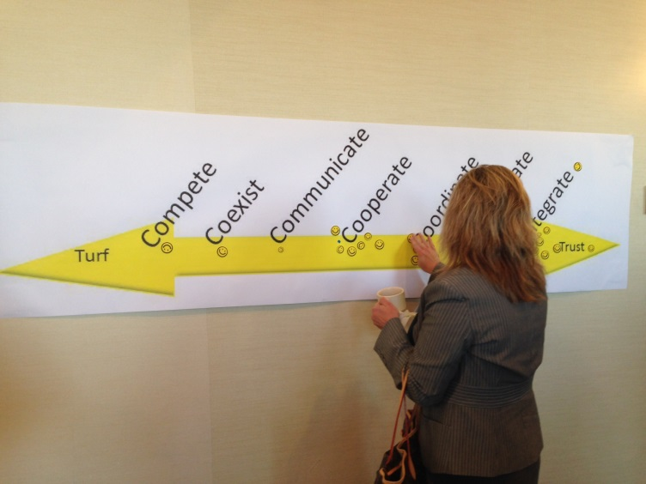
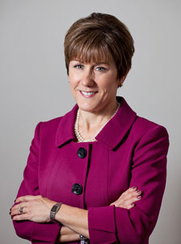
System Wide Advancement Accomplishments, Cont’d
Hosted Community Event, Nov. 2, 2015
Dynamic Partnerships: A Path Forward to a Stronger Community (Nov.2015) which featured Susan Dreyfus, President and CEO of the Alliance for Strong Families and Communities
150 community members learned about Collective Impact and began to examine their role in creating a vibrant and strong Waukesha County

Slide 17
System Wide Advancement Accomplishments, Cont’d
Thriving Funder’s Collaborative
Convened throughout the year to build understanding between funders
Participated in Collective Impact education and coordinated funding and resources to support the Homelessness Initiative
Intervened as critical community issues emerged and collectively worked to resolve concerns

Slide 18
TWCA Priorities
System-wide Advancement
Key Priority Initiatives
Homelessness
Transportation
Catalyst for strategic collaborations
Notes:
Might be able to explain here why homelessness and transportation as well.

Slide 19
TWCA Priorities Key Priority Initiatives
Goal 2: Foster innovation, collaboration, and the integration of services to support identified initiatives.
Notes:
Increase capacity of the nonprofit health and human services sector
Strengthen leadership through the Nonprofit Leadership Consortium
Devise measures for system performance
Educate Donors and Funders on investing wisely

Slide 20
TWCA Priorities Key Priority Initiatives Collective Impact Opportunities
Research from the Taskforce study identified two key priority areas:
Homelessness:
Transportation:

Slide 21
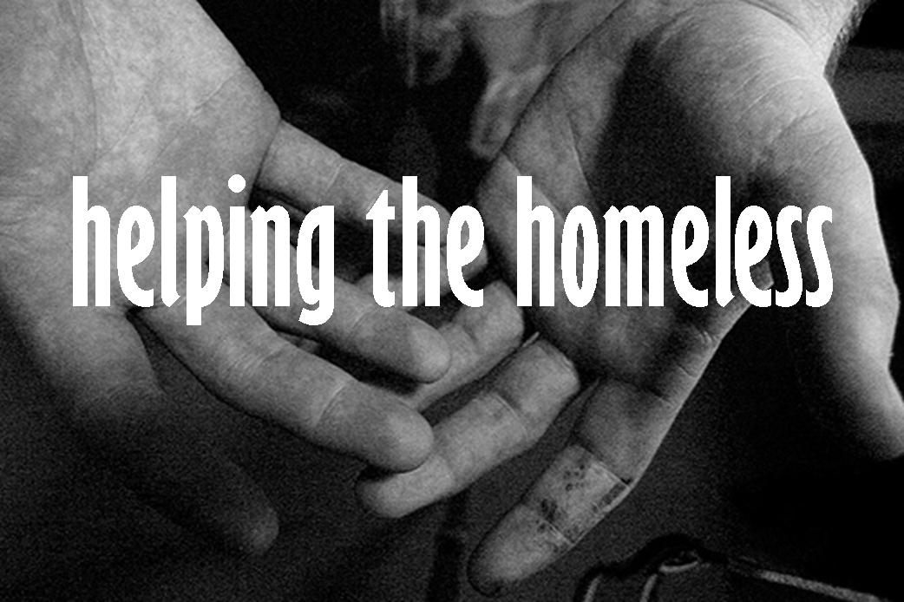
TWCA Accomplishments Homelessness Affinity Group
Community Challenge:
Eliminate homelessness in Waukesha County through a five part Collective Impact approach
Notes:
Bold and immediate action for transportation and homelessness- make the case why these were selected by Thriving

Slide 22
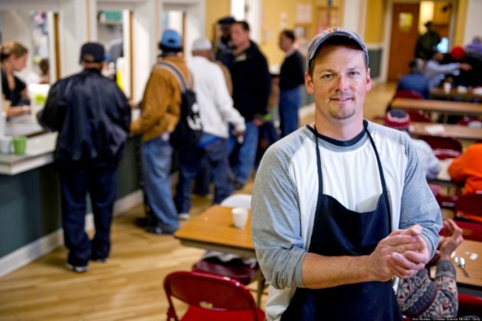
TWCA Accomplishments Homelessness Affinity Group
40+ partners
Nonprofit providers, political leaders, funders, community members collaborated to develop a comprehensive plan (Fall 2014)
Short Term
Identified resources to address winter months
Long Term
Thriving aligned resources to:
Support transition plan to reconstitute the current Housing Action Coalition (HAC) board to serve as backbone (April 2016)
New HAC Board will be able to address community needs, implement strategic plan, and conform to HUD requirements
Notes:
Bold and immediate action for transportation and homelessness- make the case why these were selected by Thriving

Slide 23
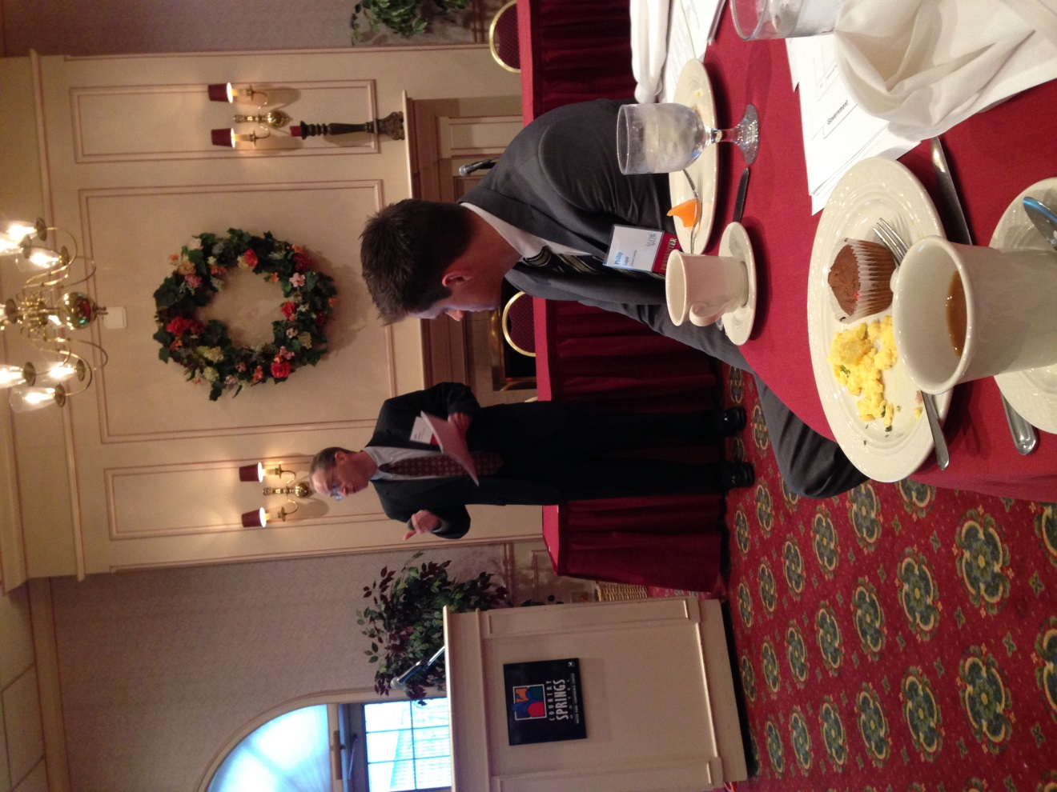
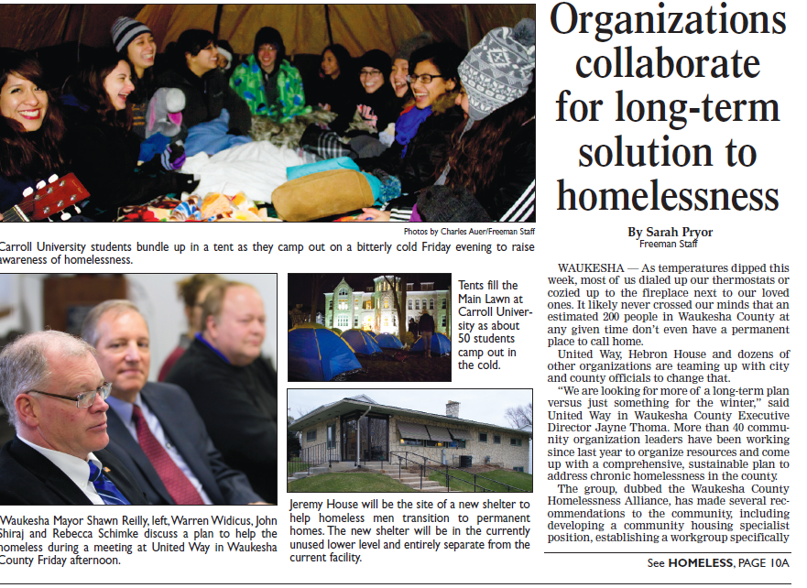
Waukesha County Homeless Alliance Press Release- Freeman 11/15/2014

Slide 24
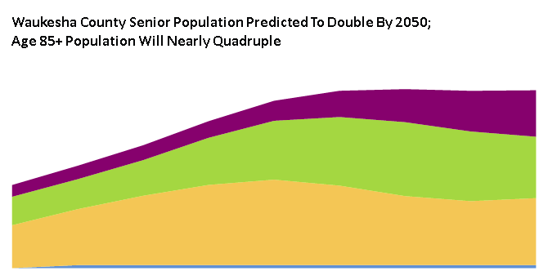
TWCA Accomplishments Transportation Affinity Group
Community Challenge:
Seniors and adults with disabilities are unable to access transportation for high priority needs, specifically healthcare services
Waukesha County’s fractured specialized transportation system poses a tremendous challenge for this population
Demand for transportation among seniors is rapidly rising
117097
55688
85+
75-84
65-74
2050
2010
Notes:
Bold and immediate action for transportation and homelessness- make the case why these were selected by Thriving

Slide 25
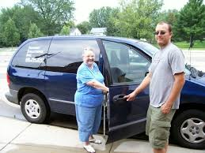
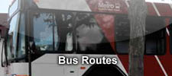
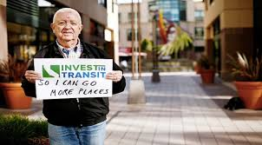
TWCA Accomplishments Transportation Affinity Group (TAG)
53 individuals representing 31 partners
Nonprofit providers, political leaders, funders, community advocacy members
Planning to “Ensure that Waukesha County possesses a transportation system that meets the needs of those who receive and those who provide health and human services in Waukesha County”
Interfaith Senior Programs along with the TAG secured a competitive federal grant of $22,000 to test potential county wide solutions
Target completion of study: 3/30/16
Anticipates seeking implementation funding in 2016

Slide 26
TWCA Priorities
System-wide Advancement
Key Priority Initiatives
Homelessness
Transportation
Catalyst for strategic collaborations
Notes:
Might be able to explain here why homelessness and transportation as well.

Slide 27
TWCA Priorities for 2016 Catalyst for Strategic Collaborations
Identification of resources to assist potential restructuring efforts
Facilitate potential partnerships

Slide 28
Catalyst for Strategic Collaborations 2015 Accomplishments
Community Challenge:
Safe Babies Healthy Families (SBHF) could not meet the growing demand for their specialized and highly effective prevention services.
Notes:
Bold and immediate action for transportation and homelessness- make the case why these were selected by Thriving

Slide 29
2015 Accomplishments Catalyst for Strategic Collaborations
Executive Director and Board of Directors courageously made the difficult decision to look for a partner organization
Thriving facilitated community conversations with SBHF and potential strategic partners, funders ,and community leaders
Short term and potential future long term funds identified
SBHF officially merged with Easter Seals of Southeast Wisconsin effective January 1, 2016

Slide 30
2016 Community Conversations Catalyst for Strategic Collaborations
Adult Dental Services: Convened key agencies to discuss strategic collaboration on critical adult dental services initiative (began summer 2015)
Limited care options for T-19 and underinsured individuals
Importance of prevention initiatives
A small but important non-profit: After completing 6-month Financial Learning Series realized their current structure is not sustainable and are exploring other options for the future

Slide 31
What can I do to support the Thriving Waukesha County Initiative? Agency Executives and Board Members
Implement best practices for management
Seek strategic collaboration with other agencies
Ask whether your financial position is secure
Attend professional and governance educational offerings
Ask how new approaches can increase capacity
Participate in pilot projects to test innovations

Slide 32
What can I do to support the Thriving Waukesha County Initiative? Donors and Funders
Continue role as lead partners
Increase awareness of Thriving
Insist on data demonstrating effectiveness of use of funds.
Support TWCA with funds for governance and management training
Consider granting sustaining funds for operational stability
Collaborate with other donors to leverage funds for collective impact

Slide 33
What can I do to support the Thriving Waukesha County Initiative? Community
Support non profit health and human services agencies
Support United Way, community foundations, and other organizations funding for greatest impact
Volunteer!

Slide 34
What can I do to support the Thriving Waukesha County Initiative? County Leaders
Continue role as lead partner (along with United Way, Waukesha County Community Foundation and Greater Milwaukee Foundation)
Increase awareness of Thriving on County Board and Departments
Support Thriving directly with continued in-kind donation of services or potential investment of funds
Notes:
What does it mean to continue as a lead partner? We need county to leverage their influence to create a stronger nonprofit sector. Mutual reliance.

Slide 35
Thank you for supporting the Thriving Waukesha County Alliance We are making a difference!
Questions & Feedback
Terri Phillips, Project Coordinator
Any questions or suggestions?
twcapm@gmail.com
www.unitedwaygmwc.org/TWCA

